Slide 1
BSc Informatics &
Telecommunications

Slide 2
BSc Informatics &
Telecommunications
MSc Informatics & AI

Slide 3

BSc Informatics &
Telecommunications
MSc Informatics & AI
PhD Machine Learning

Slide 4
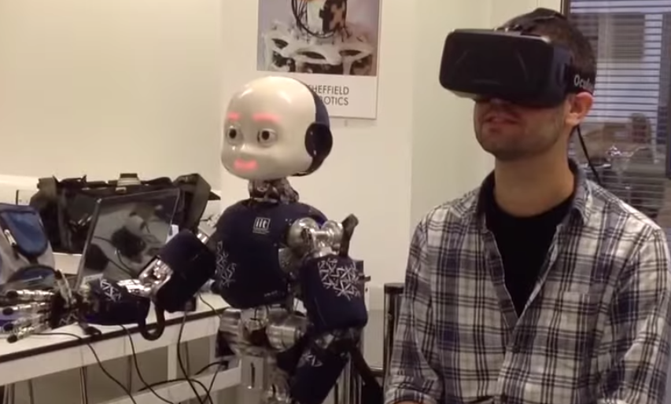
BSc Informatics &
Telecommunications
MSc Informatics & AI
PhD Machine Learning
Researcher ML & Robotics

Slide 5
BSc Informatics &
Telecommunications
MSc Informatics & AI
PhD Machine Learning
Researcher ML & Robotics
Start-up

Slide 6
BSc Informatics &
Telecommunications
MSc Informatics & AI
PhD Machine Learning
Researcher ML & Robotics
Start-up
ATI Fellowship

Slide 7
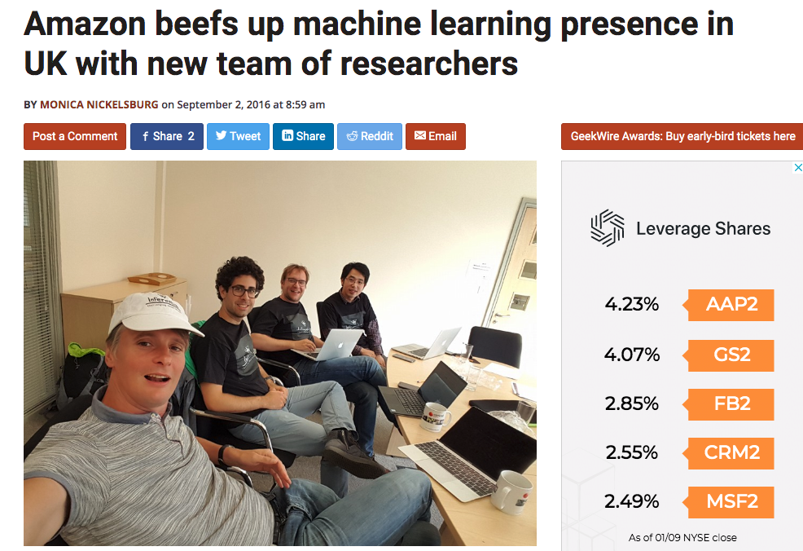
BSc Informatics &
Telecommunications
MSc Informatics & AI
PhD Machine Learning
Researcher ML & Robotics
Start-up
ATI Fellowship
Amazon

Slide 8
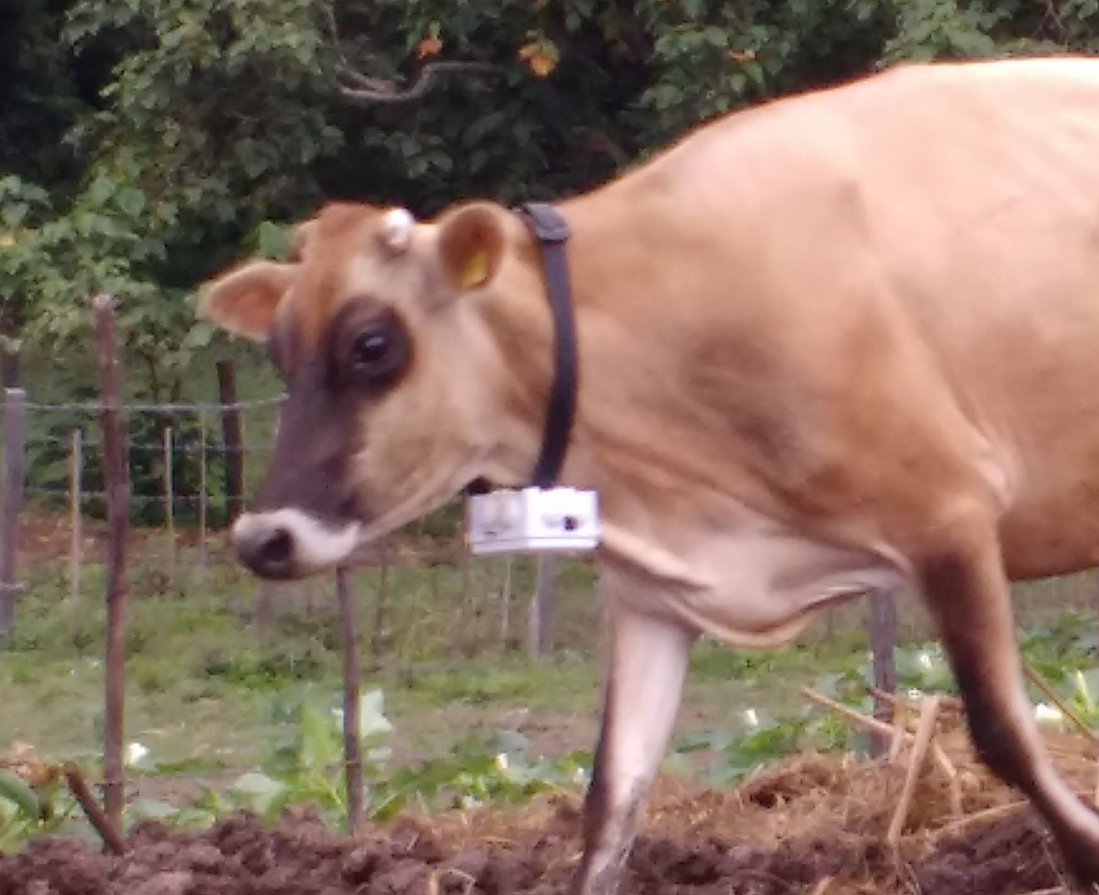
Data Science Africa

Slide 9
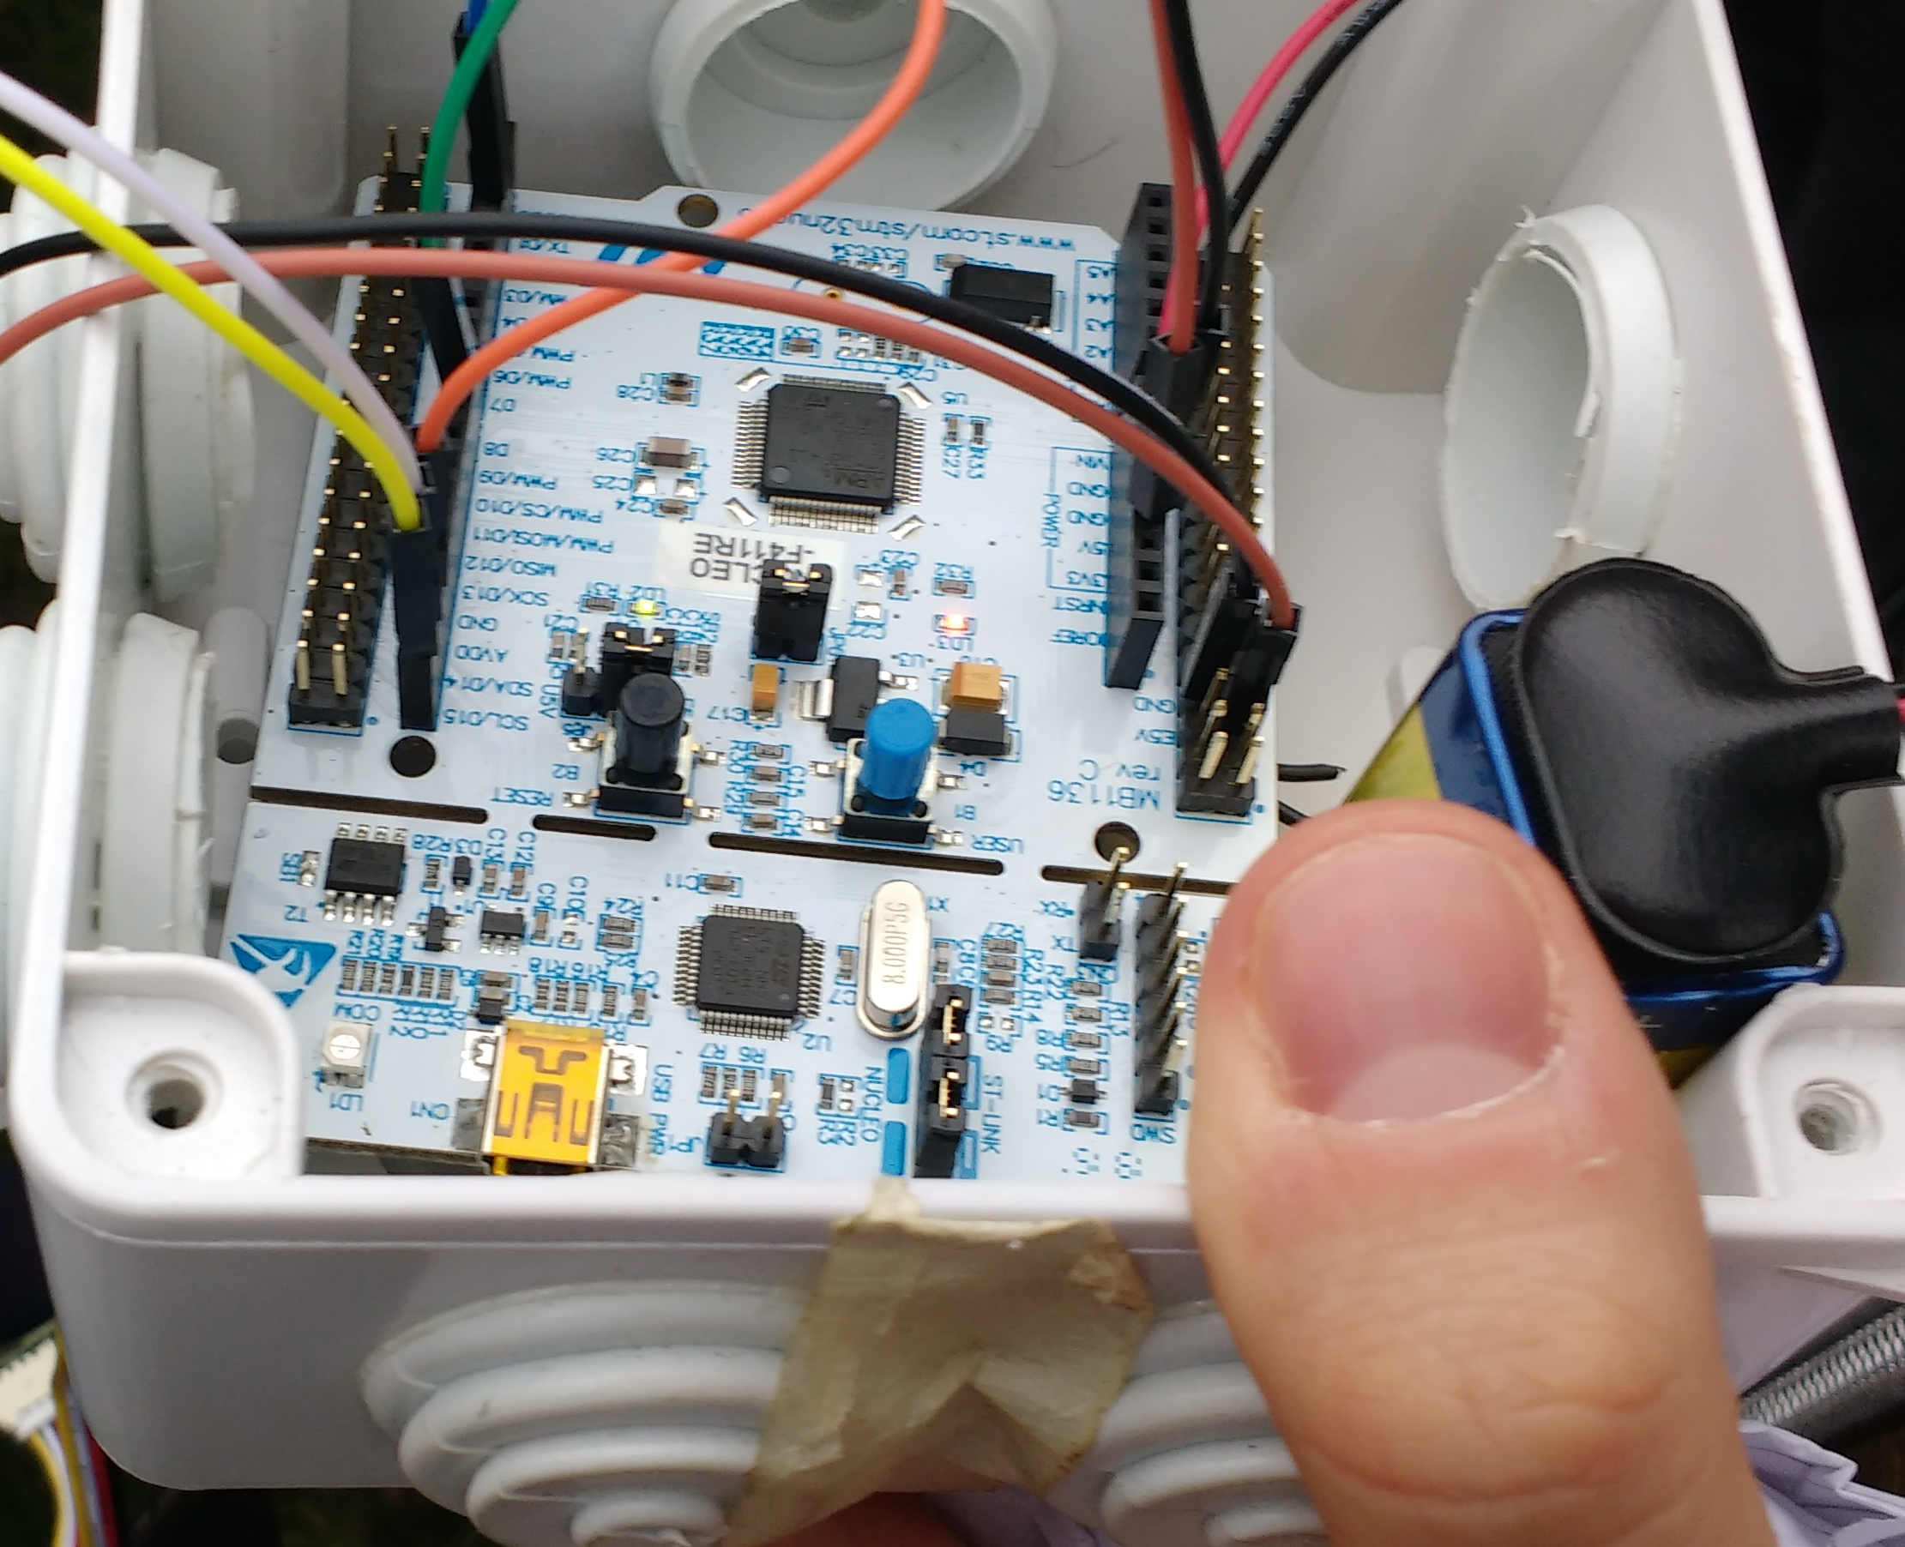
Data Science Africa
ARM Mbed

Slide 10
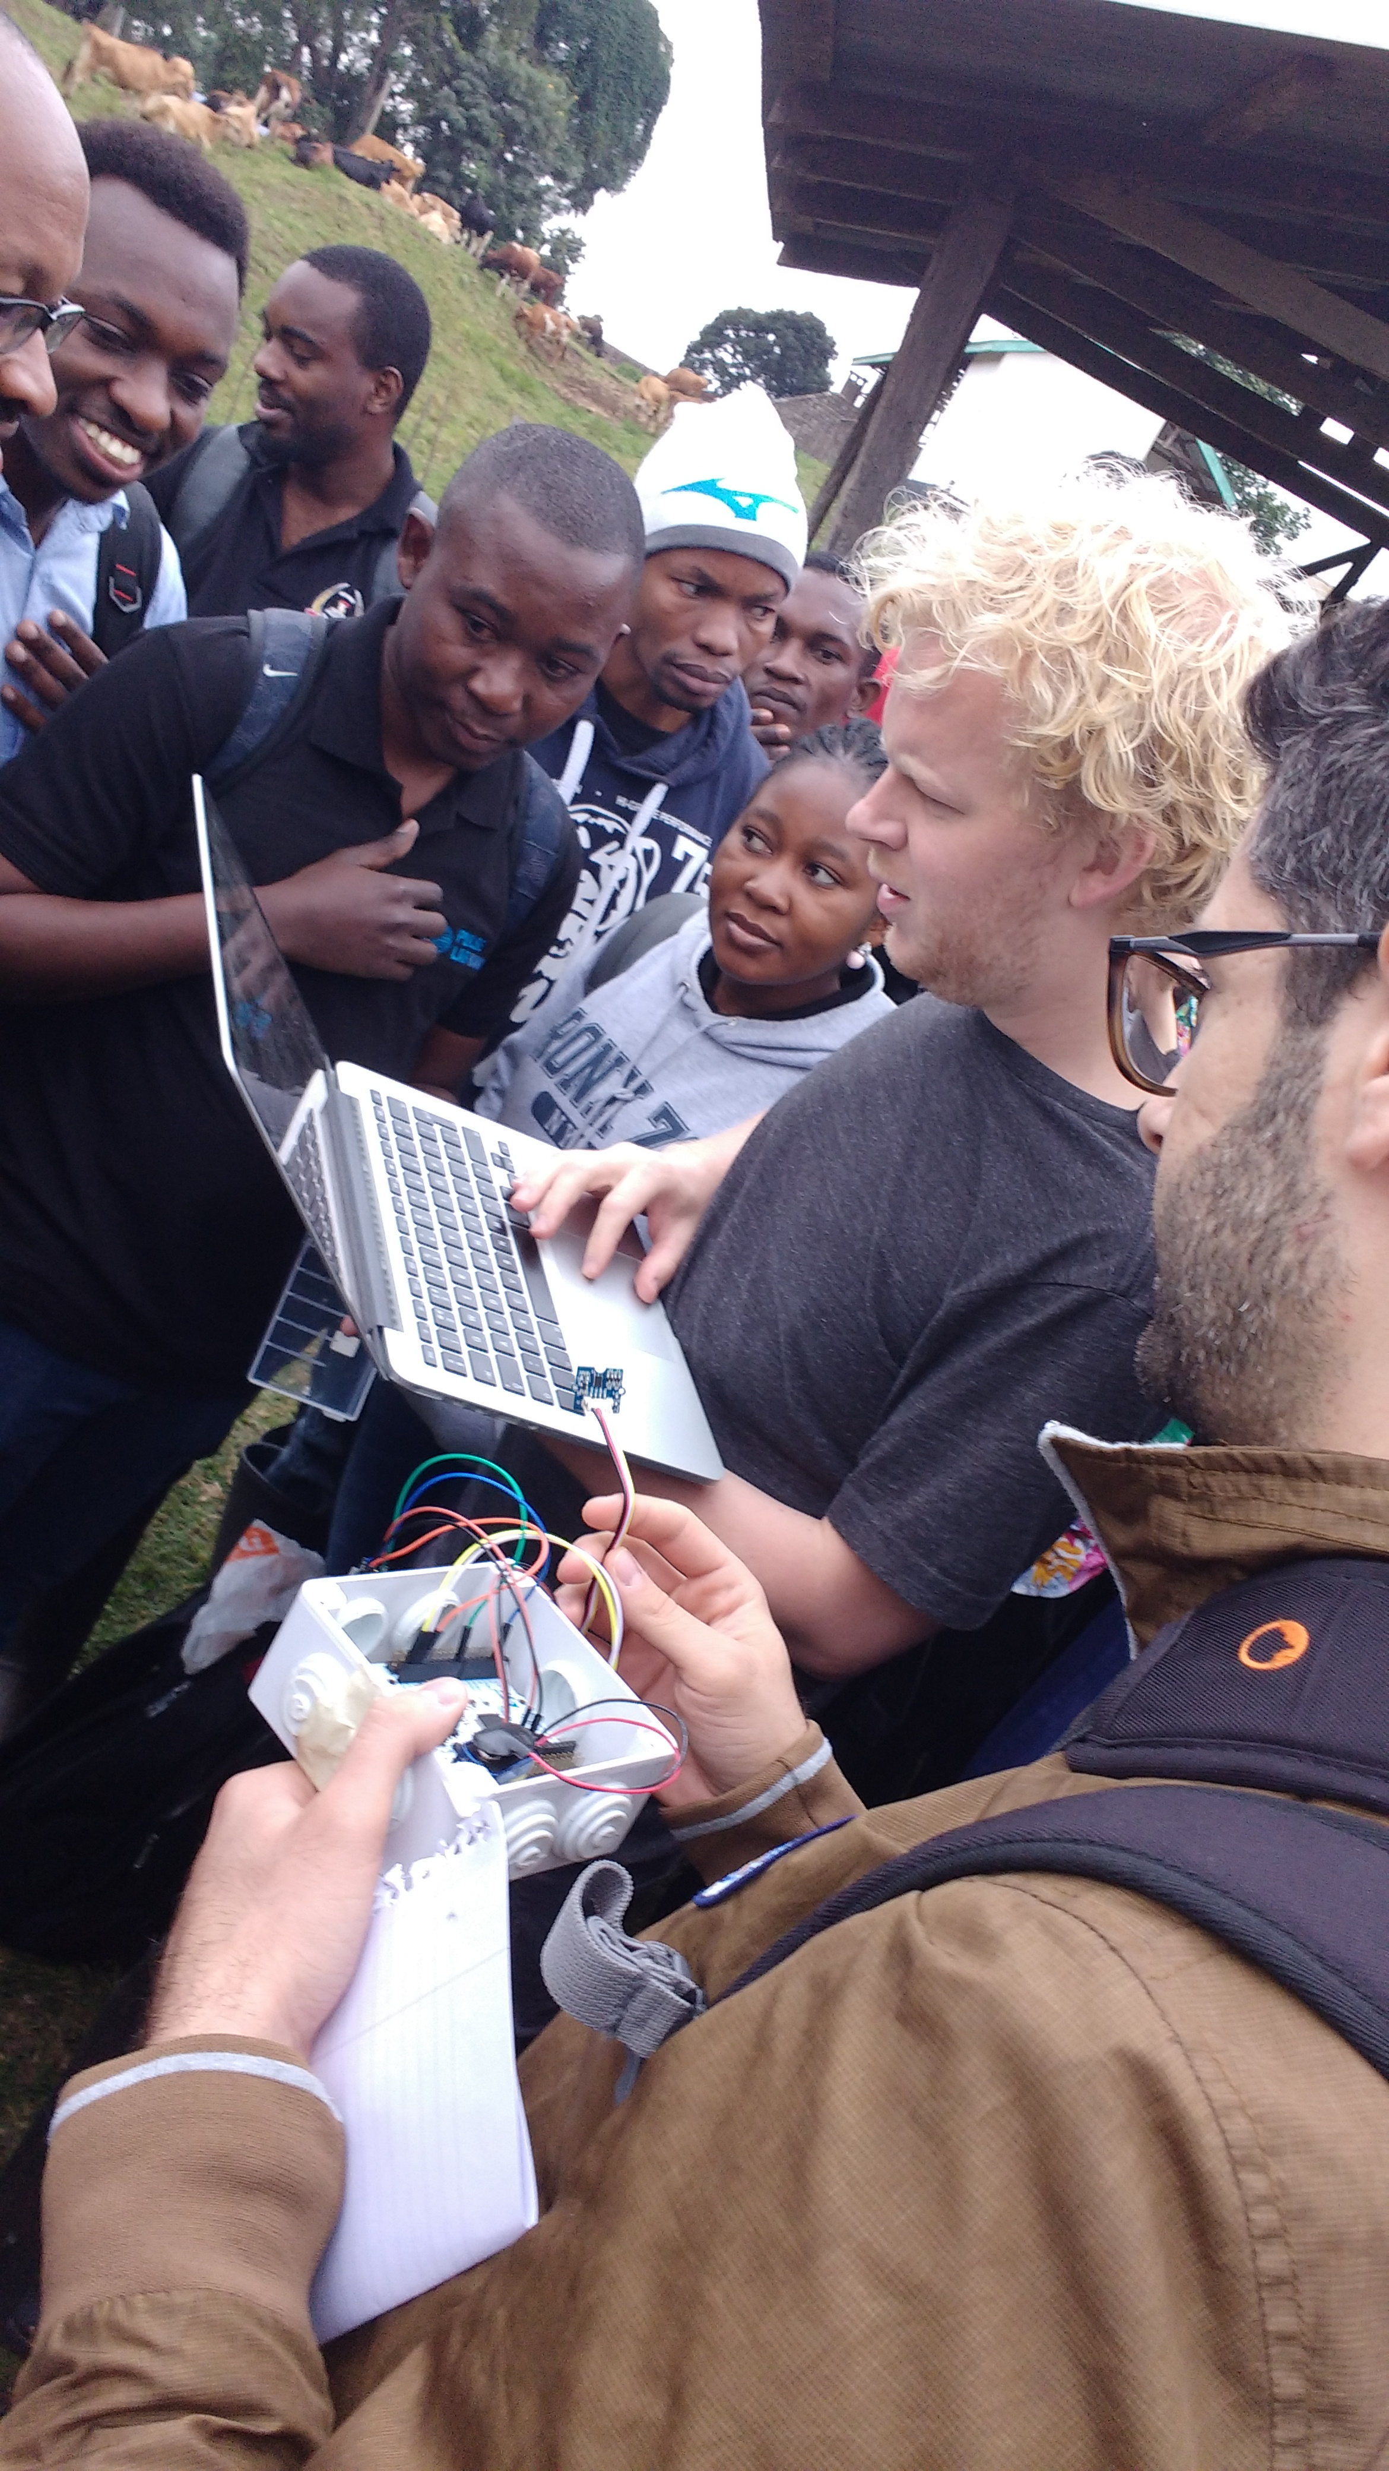
Data Science Africa
ARM Mbed
Gaussian process

Slide 11
Topics covered
Why we want to model uncertainty, and how.
Bayesian neural networks
(Deep) Gaussian processes
Challenges / computational considerations
Efficient implementation & the (potential) role of hardware
The best (?) of neural network and Gaussian process world

Slide 12
Notes
Ensure Bayesian idea is communicated
Notes:
NOTE: Gps require fewer iterations of training than most parametric models because they hvave few hyperparameters. That is before approximations kik in.
TODO:
Check in Wilson’s and Pleiss paper what they do with Wx (is it still KISS-GP or parallelization allows exact?).
=> See footnote 2 in exact GP paper: that paper has O(n) prediction. It’s the lowest you can do in exact GPs using Lanczos, because for exact you need to see each datapoint at least once. But it can be parallelized and they say it takes <sec in 1 GPU even for n=10^6 . However, we can further reduce to O(1) (actually O(k) with k small) if we couple Lanczos with KISS-GP, ie the Pleiss paper. This is now an approximation relying on the KISS-GP trick of gridding. I think we can start with KISS-GP + LOVE (Pleiss) and then allow Wx to just be a matrix including weight 1 for every inducing point, where inducing points == data points. Then we have a single equation to describe. (or we could do it vice versa).
This paper shows how instead of Cholesky we can do CG which is optimization-based, and requires products. This might also turn out to be easier to work wrt numerical issues. But still, what happens with numerics hasn’t been addressed. See below.
Check bits back argument. Then argue that this could become the basis for mixed precision (e.g. for BNNs ala Louizos or for ensembles or even extend to the Pleiss paper).
Another way to see our paper with Wesley which can be used here: we now have methods to scale predictions using precomputations of parts containing training data. But for big data, it’s still infeasible to train the GP (so how to predict with it well?) . For this reason, we can train instead a NN and then at test time convert it to a GP. (although ”exact GP” paper allows pretty big data). This also allows to maintain hierarchical features and also to ”tips of the trade” as well as invariances such as CNN.
- Add the GPU GP paper and the Distillation paper somewhere
Remember to note:
- http://adamian.github.io/talks/Damianou_GP_tutorial.html
- Xfer
Need to add some cool results somewhere

Slide 13
Uncertainty is lack of knowledge
Aleatoric uncertainty: Will the patient respond to the treatment?
Epistemic uncertainty: Does the patient have cancer?
Notes:
- Aleatoric uncertainty
Aleatoric uncertainty is also known as statistical uncertainty, and is representative of unknowns that differ each time we run the same experiment.
- Epistemic uncertainty
Epistemic uncertainty is also known as systematic uncertainty, and is due to things one could in principle know but doesn’t in practice. This may be because a measurement is not accurate, because the model neglects certain effects, or because particular data has been deliberately hidde

Slide 14
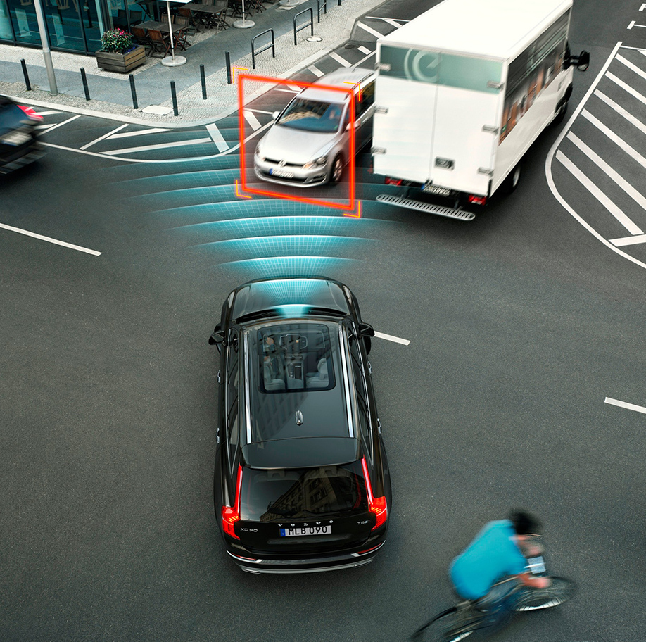
Sources of uncertainty [U.S. Dept. of Enegy 2009]
Systematic & stochastic measurement error
Ignorance
Limitations of models
Limitations of numerical representations of models
Limitations in accuracy of computations
Human error
Notes:
Image: https://readyforai.com/article/the-latest-development-of-artificial-intelligence-medical-applications-in-2018/

Slide 15
Uncertainty in every part of the system
Can we account for uncertainty in training and predictions?
Modeling pipeline
Model Spec.
Computation
Training data
Input
Output
Assumptions
Ignorance
Model limitations
Accuracy limits
Round-off error
Measurement error
Train set bias
Human error
Uncertainty = errors + lack of knowledge.
Notes:
Typically, in a prob. model we could say p(w) is epistemic and \epsilon is aleatoric.

Slide 16
Uncertainty in every part of the system
Can we account for uncertainty in training and predictions?
Modeling pipeline
Model
Computation
Training data
Input
Output
Assumptions
Ignorance
Model limitations
Accuracy limits
Round-off error
Measurement error
Train set bias
Human error
Deterministic model:
Uncertainty = errors + lack of knowledge.

Slide 17
Need for uncertainty
Quantifying what “you don’t know”:
Acts as a regularizer during training
Helps to avoid overfitting
Allows us to inspect the system & collect better data
Provides uncertainty in predictions, useful for downstream tasks (health; self-driving cars)
→ Better human-computer collaboration

Slide 18
Bayesian uncertainty modeling
In a nutshell:
Do not learn single optimal values of parameters w’. Learn distributions p(w | data)
Predictions: p(y* | data*, w’) [no uncertainty] turns into \int p(y*| data*, w) p(w | data) dw -> this has uncertainty
GPs: \int p(y* | f*) p(f* | data) df

Slide 19
Probabilistic deep learning
See also: http://adamian.github.io/talks/Damianou_deep_learning_rss_2018.pdf

Slide 20
A standard neural network

Slide 27
Single point vs full posterior
Notes:
Area on the left might be better for some test data

Slide 28
Single point vs full posterior
Notes:
Area on the left might be better for some test data

Slide 31
Notes:
(Remember we have to sample from every q(w). We don’t have a big correlated distribution. )
This slide has the take-home message: computing posteriors and doing integration rather than optimization gives the probabilistic model with uncertainty.
==== PAUSE and ask for questions ====

Slide 32
Energy-efficient predictions using uncertainty
Some (I believe) relatively unexplored directions:
Compress and naturally we then have fewer weights (for BNN).
Mixed-precision: Compute the bits needed for each weight [Louizos et al.] within a posterior.
Mixture of experts ensemble: “bad” experts get allocated fewer bit-precision (inspired by MC-dropout).
Bayesian student-teacher distillation [Ahn, Hu, Damianou, Lawrence, Dai] for BNNs.
Notes:
A bit out of my comfort zone but I think interesting for the audience.

Slide 33
Bayesian student-teacher [Ahn, Hu, Damianou, Lawrence, Dai 2019]
Mutual Information
Notes:
==Questions so far?==

Slide 34
Take home messages
1. Uncertainty in NNs possible but costly. Potential directions to make frugal.

Slide 35
Distribution on parameters induces uncertainty in function:

Slide 36
Distribution on parameters induces uncertainty in function:
Can we model uncertainty directly in the function space?

Slide 37
Gaussian processes
See also: adamian.github.io/talks/Damianou_GP_tutorial.html

Slide 39
Prob. view is MAP; Bayesian view (Add): integrate
Add also Bayes rule
Predictive uncertainty in BNN (see (1) in https://arxiv.org/pdf/1906.11537.pdf) in practice with MC. Costly
Then add directly f instead of w. And then in next slides we see how this is done.

Slide 40
Take home message:
- Uncertainty captured through Bayes rule: Explicit prior; posterior *distr.* ; predictive using average
- Integration vs optimization: Integration is the denominator in Bayes rule and needs to be computed.

Slide 45
Train a GP means fitting θ
Notes:
instead of estimating a matrix i have a func that gives me the elements i need.

Slide 49
Notes:
Add density gray area
QUESTIONS?

Slide 50
Take home messages
Uncertainty in NNs possible but costly. Potential directions to make frugal.
A GP is a distribution over functions. Relies on a kernel k(x,x’).

Slide 51
GP as the limit of a Bayesian NN
Limit of infinite num. parameters: Optimization of finite num. parameters → Integration of infinite model
Closed form solution for modelled function class!
…
…
GP
Neal 1994; Williams 1997

Slide 52
Benefits of modeling in function space
Closed form integration corresponds to “perfect” optimization.
Easy to add prior knowledge/assumptions.
Intuitive/interpretable modeling.
Well-calibrated uncertainty.
Notes:
(Interpretable modeling: think about compression)

Slide 53
Notes:
k*n is cross cov.
Instead, neural networks allow for easy parallelization, SGD etc.

Slide 54
Computational speed-up
Low rank approximations(see also num. stability)
GPU GP (Dai et al.)
Pleiss et al.
Learnability
DGP
NTK_GP
(reparameterization? Ie back-constrained?)
Numerical stability
http://www.jmlr.org/papers/volume10/foster09a/foster09a.pdf
NTK_GP (preconditioners)

Slide 55
Non-parametric: Allows to argue about the function space directly.
This comes with challenges: we cannot rely on optimization for parts of the system that we don’t understand.
Example: For NNs we can set some weights to zero to compress. We don’t know what this means in the function space, but we hope optimization will cope.
For GPs, we can still do compression. It’s just that we have to figure out a way to do it through the function space. It’s more difficult, but if we do manage, then we know exactly what we get/what we lose.
However, there is one thing that we might indeed lose: hierarchical feature learning (baby and bathwater). Let’s fix this: (a) DGPs (b) Linearized NNs as GPs.

Slide 56
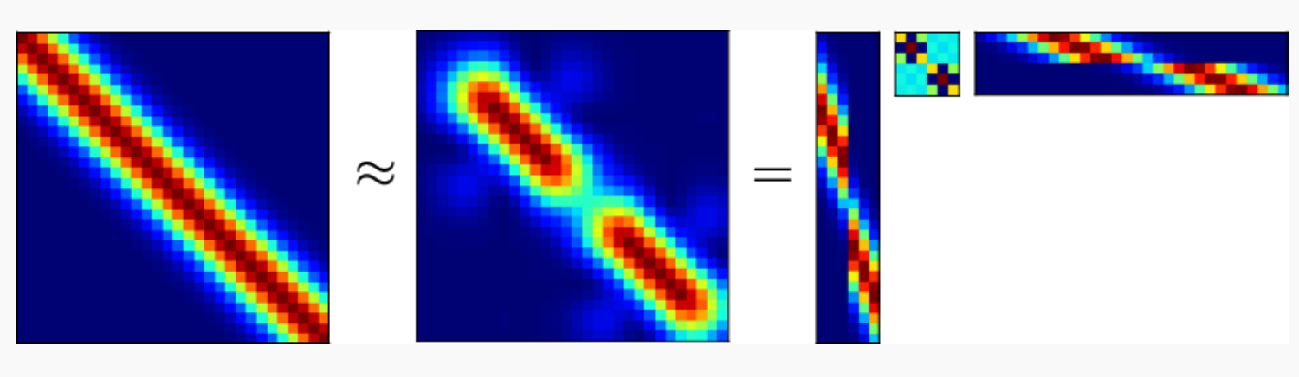

Distributed computations with GPU acceleration
Inversion of a much smaller matrix
Parallel computations!
[Dai, Damianou, Hensman, Lawrence, “GP models with Parallelization and GPU acceleration”, 2014]
Notes:
Approximate Kff with Kfu Kuu^{-1} Kuf
With rewriting the traces we get terms of the form:
Kuf Kfu = \sum_n Kuf_n Kf_nu <- this can be parallelized
Then inversion is (b Kuf Kfu +Kuu)^{-1}
So we distribute the first part before + and then once that’s done we do inversion for a m x m matrix. This is similar to the technique used by Wilson et al (kind of ) but they do it for Lanczos and kiss-GPs.
\mathbf{K}_{nm}\mathbf{K}_{mn} = \textstyle\sum\nolimits_i \mathbf{K}_{mi} \mathbf{K}_{im}

Slide 57
Distributed computations with GPU acceleration
Inversion of a much smaller matrix
Parallel computations!
[Dai, Damianou, Hensman, Lawrence, “GP models with Parallelization and GPU acceleration”, 2014]
Notes:
Approximate Kff with Kfu Kuu^{-1} Kuf
With rewriting the traces we get terms of the form:
Kuf Kfu = \sum_n Kuf_n Kf_nu <- this can be parallelized
Then inversion is (b Kuf Kfu +Kuu)^{-1}
So we distribute the first part before + and then once that’s done we do inversion for a m x m matrix. This is similar to the technique used by Wilson et al (kind of ) but they do it for Lanczos and kiss-GPs.
\mathbf{K}_{nm}\mathbf{K}_{mn} = \textstyle\sum\nolimits_i \mathbf{K}_{mi} \mathbf{K}_{im}

Slide 58
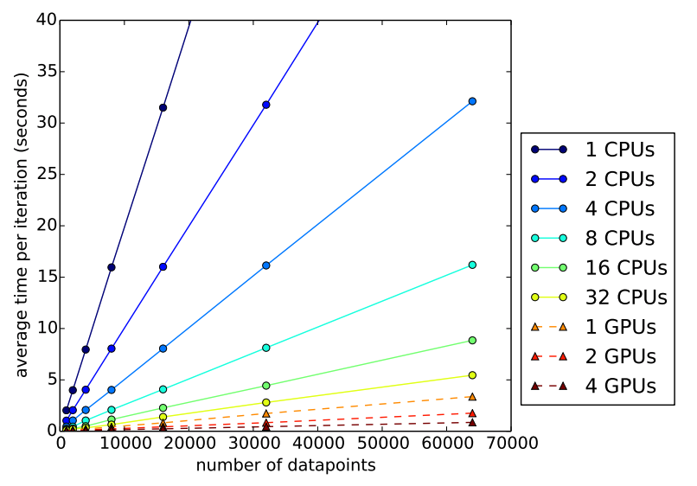
Linear scaling (wrt n) for training!

Slide 61
[Pleiss et al. 2018]

Slide 62
[Pleiss et al. 2018]

Slide 63
Challenges #2: Learnability
In the presence of finite data the analytic solution might not be the best!
Neural networks, instead, perform hierarchical concept learning.
Notes:
#### Concept learning:
Sometimes we do not know what the concepts are so we can’t make compositions. We talk about classifying cats and dogs, but classification of natural scenes is not the easiest problem.
#### Early stopping from NTK paper: ####
Map SGD learning to learning in the function space with a kernel. You can define a map to find the kernel principal of the data with respect to the kernel. The corresponding eigenvalues λi is the variance captured by the component.
The above decomposition can be seen as a motivation for the use of early stopping. The convergence is indeed faster along the eigenspaces corresponding to larger eigenvalues λi. Early stopping hence focuses the convergence on the most relevant kernel principal components, while avoiding to fit the ones in eigenspaces with lower eigenvalues (such directions are typically the ‘noisier’ ones: for instance, in the case of the RBF kernel, lower eigenvalues correspond to high frequency functions).

Slide 64
Did we throw the baby out with the bathwater? (D. MacKay)
Maybe having finite parameters is the way to approximate GPs in a manageable way??
learnability
Notes:
Basically: Did we overdo it trying to get uncertainty? Maybe having finite params. *is* what we want since we know better how to handle optimization? After all a GP *is* a neural network, but approximated with finite weights. Then we just have to optimize.
Answer: We also can learn how to handle integration. It’s just more difficult. But we can also create hybrid models where learning is performed in the finite world and then transformed into infinite.
DGP fixes hierarchical concept learning;
GP_NTK fixes both.
#### Concept learning:
Sometimes we do not know what the concepts are so we can’t make compositions. We talk about classifying cats and dogs, but classification of natural scenes is not the easiest problem.
#### Early stopping from NTK paper: ####
Map SGD learning to learning in the function space with a kernel. You can define a map to find the kernel principal of the data with respect to the kernel. The corresponding eigenvalues λi is the variance captured by the component.
The above decomposition can be seen as a motivation for the use of early stopping. The convergence is indeed faster along the eigenspaces corresponding to larger eigenvalues λi. Early stopping hence focuses the convergence on the most relevant kernel principal components, while avoiding to fit the ones in eigenspaces with lower eigenvalues (such directions are typically the ‘noisier’ ones: for instance, in the case of the RBF kernel, lower eigenvalues correspond to high frequency functions).

Slide 65
Did we throw the baby out with the bathwater? (D. MacKay)
Maybe having finite parameters is the way to approximate GPs in a manageable way??
No! We can handle GPs in the function space just fine. It just requires tools beyond optimization.
Let’s see how we can fix the issues one by one.
learnability
Notes:
Basically: Did we overdo it trying to get uncertainty? Maybe having finite params. *is* what we want since we know better how to handle optimization? After all a GP *is* a neural network, but approximated with finite weights. Then we just have to optimize.
Answer: We also can learn how to handle integration. It’s just more difficult. But we can also create hybrid models where learning is performed in the finite world and then transformed into infinite.
DGP fixes hierarchical concept learning;
GP_NTK fixes both.
#### Concept learning:
Sometimes we do not know what the concepts are so we can’t make compositions. We talk about classifying cats and dogs, but classification of natural scenes is not the easiest problem.
#### Early stopping from NTK paper: ####
Map SGD learning to learning in the function space with a kernel. You can define a map to find the kernel principal of the data with respect to the kernel. The corresponding eigenvalues λi is the variance captured by the component.
The above decomposition can be seen as a motivation for the use of early stopping. The convergence is indeed faster along the eigenspaces corresponding to larger eigenvalues λi. Early stopping hence focuses the convergence on the most relevant kernel principal components, while avoiding to fit the ones in eigenspaces with lower eigenvalues (such directions are typically the ‘noisier’ ones: for instance, in the case of the RBF kernel, lower eigenvalues correspond to high frequency functions).

Slide 66
Deep Gaussian process
where
[Damianou, Lawrence. “Deep Gaussian processes”, 2013]
[Damianou, “Deep Gaussian processes and variational propagation of uncertainty”, PhD Thesis]
[Kumar, Singh, Srijith, Damianou, “Deep Gaussian processes with convolutional kernels”, 2018]

Slide 67
Deep Gaussian process [Damianou,, PhD Thesis]
X
H
Y
Notes:
Describe quickly if no time

Slide 68
Notes:
combine GP with deep learning
Fast predictions by building on Pleiss et al. We also show that the required J J^T can be fast by casting it as an optimization problem as follows:
J J^T is related to fisher matrix F
Fisher matrix can be obtained as the solution of a Taylor expansion of the KL divergence. So we solve that with optimization instead of analytically.

Slide 69
Notes:
Fast predictions by building on Pleiss et al. We also show that the required J J^T can be fast by casting it as an optimization problem as follows:
J J^T is related to fisher matrix F
Fisher matrix can be obtained as the solution of a Taylor expansion of the KL divergence. So we solve that with optimization instead of analytically.

Slide 70
GP with NN inductive biases
Here J(X; Θ) = d NN(x; θ ) / d θ

Slide 71
Amount of bits
Notes:
Out of my comfort zone but thought it’s both relevant to the rest of the talk and to the audience. Come after discussing with Partha and Igor.
I think they use the variance as measure of bits needed; this could be related to the fact that for Gaussians, the entropy (i.e. number of bits) is depending only on the variance.
Ensembles: model averaging (e.g. MC sampling is doing that) or mixture of experts.

Slide 72
Can we implement GPs in hardware?
Not currently. However, I think it’s possible (but also hard!).
We can turn inversions into matrix-vector-products. HW is good at that (and can parallelize).
Prediction with clever caching can be fast.
Learning is feasible by incorporating inductive biases from NNs.
Biggest unexplored issue is the needed precision (1. can partially help).
Brainstorming:
Energy efficient using mixed-precision informed by the models’ self-doubt (entropy). Implicit or explicit mixture of experts.
DGP architecture search to compress a bigger GP.
Notes:
For the last point: we train DGPs on data. But that’s a very flexible model difficult to learn. What if we have the objective function to do student teacher from a GP to a DGP? See Carl-Henrik’s work. ← Example using toy data!
See also https://arxiv.org/pdf/1905.10969.pdf

Slide 73
Can we implement GPs in hardware?
Not currently. However, I think it’s possible (but also hard!).
We can turn inversions into matrix-vector-products. HW is good at that (and can parallelize).
Prediction with clever caching can be fast.
Learning is feasible by incorporating inductive biases from NNs.
Biggest unexplored issue is the needed precision (1. can partially help).
Brainstorming:
Energy efficient using mixed-precision informed by the models’ self-doubt (entropy). Implicit or explicit mixture of experts.
Deep GP architecture search to compress a bigger GP.
Notes:
For the last point: we train DGPs on data. But that’s a very flexible model difficult to learn. What if we have the objective function to do student teacher from a GP to a DGP? See Carl-Henrik’s work. ← Example using toy data!
See also https://arxiv.org/pdf/1905.10969.pdf

Slide 74
Conclusion
Uncertainty modeling turns optimization into integration.
Challenges: expensive computations; required precision.
Computations more economical with recent advances and GPUs.
Deep GP and GP-NN hybrids allow for uncertainty modelling with good learnability.
I shared some thoughts on uncertainty modelling in hardware.

Slide 75
Thanks!
Questions?
Relevant tutorials & publications: andreasdamianou.com

Slide 76
Appendix

Slide 77
GPs *for* hardware
“[round-off errors] are strictly very complicated but uniquely defined number theoretical functions [of the inputs], yet our ignorance of their true nature is such that we best treat them as random variables.”
(von Neumann and Goldstine 1947, p. 1027).
We can actually use Gaussian processes to model uncertainty coming from the computation of hardware.
(Verification & Testing?)

Slide 78
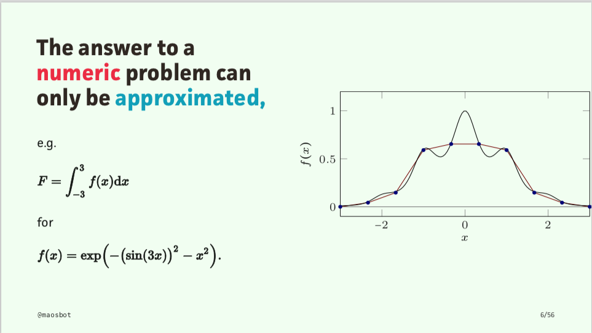
Slide from Michael Osborne

Slide 79
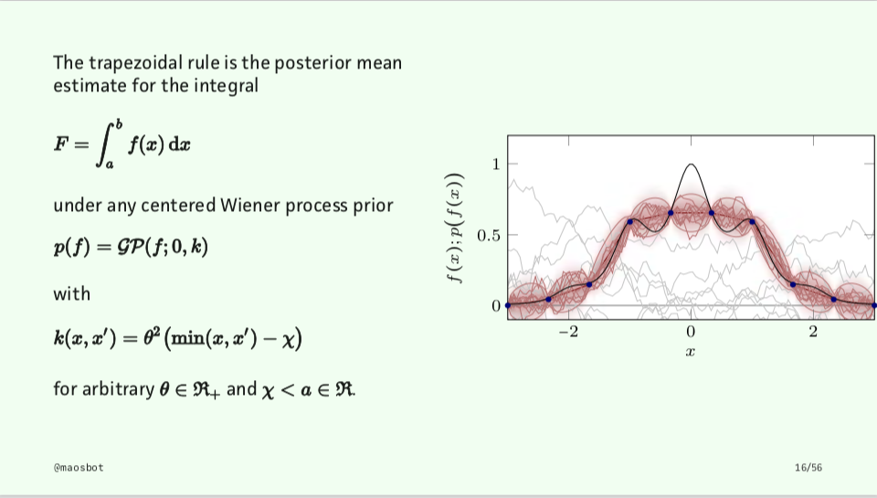
Slide from Michael Osborne

Slide 80
Computational complexities
exact-GP : O(n^2)
KISS-GP+Lanczos : O(t).
exact-GP+Lanczos : O(tn) but k is very small
sparseGP : O(m^2) but m is typically large
sparseGP+Lanczos : O(km)
Notes:
% - exact-GP : O(n^2)
% - KISS-GP+Lanczos : O(k). Actually O(km) but m goes away since it has only 4 non-zero elements that matter for this computation.
% - exact-GP+Lanczos: O(kn) but k is very small so they refer to it as O(n) (I think).
% - sparseGP : O(m^2) but m is typically large
% - sparseGP+Lanczos: O(km)

Slide 81
Storage costs
exact-GP : O(n^2)
KISS-GP+Lanczos : O(tm)
exact-GP+Lanczos : O(tn) [but parallelizable]
sparseGP : O(m^2)
sparseGP+Lanczos : O(tm)
Notes:
% ===
% Memory for precomputation:
% - exact-GP : O(n^2) [Kxx is n x n]
% - KISS-GP+Lanczos : O(km) <- here I don't get benefit from the fact that only some elements matter for the computation; I obviously have to store all.
% - exact-GP+Lanczos: O(kn) [I think; but parallelizable]
% - sparseGP : O(m^2)
% - sparseGP+Lanczos: O(km) [I think]
% So SparseGP + Lanczos or KissGP+Lanczos are good solution. In any case, after we cache the training part, the predictive GP just involes Matrix-vector multiplications, which can be done fast and in parallel.

Slide 83
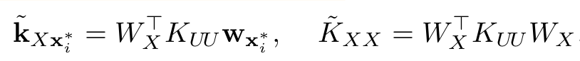
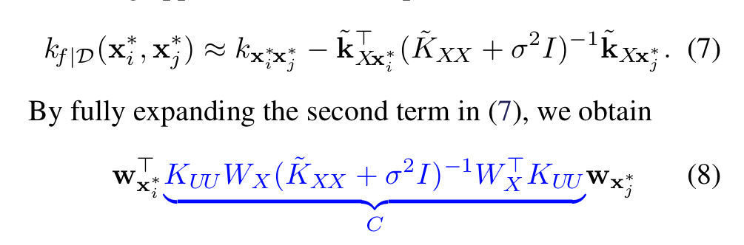
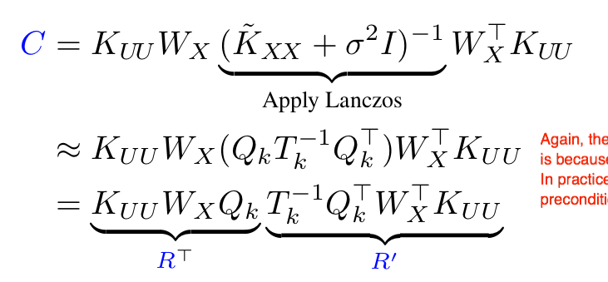
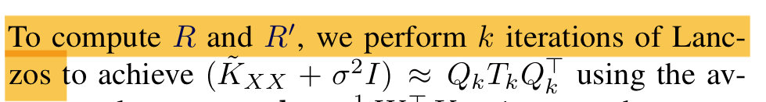
Fast predictive variances
Approximate covariance using points in grid with weight W
Replace in GP predictive equation.
Precomputing C with Lanczos.
C precomputed with t iterations, giving us structure R^T R
R is m x t

